Slide 1
Furniture Sales forecast
By Krishna shinde
(ML Engineer)

Slide 2
Project Introduction
Every business owner’s objective is to estimate the future trends – in terms of sales, profits, gains etc. To do this analysis, the owner first has to segregate the data by category and analyze each entity separately. For each entity, a forecast can be estimated based on the past sales of that entity. The idea behind this is to find out the popularity of a certain product and how its sales can impact the business
Problem Statement
Build a forecast model to predict the Furniture sales of a certain store

Slide 3
Data Source-Describe the data
This data set is provided by NIIT . It contains 9994 samples and 21 features.
Since It is forecasting project and in data time stamp is also added so Time Series analysis will perform better here.
S.No | Feature | Data Type | Description
1 | Row ID | Numeric | Unique row identifier
2 | Order ID | Alphanumeric | Order ID
3 | Order Date | Date | Date when the order was made
4 | Ship Date | Date | Date when the order was shipped
5 | Customer ID | Alphanumeric | Customer ID for which the order has been placed
6 | Customer Name | Character | Customer name
7 | Segment | Categorical | Type of Business (Consumer / Corporate / Home Office)
8 | Country | Character | Customer’s Country of origin
9 | City | Character | Customer’s city
10 | State | Character | Customer’s state
11 | Postal Code | Numeric | Address Zip code
12 | Region | Categorical | Geographical location of the state within the country
13 | Product ID | Alphanumeric | Product identification code
14 | Category | Categorical | Product category
15 | Sub Category | Character | Specific product belonging to a given product category
16 | Product Name | Character | Product name
17 | Sales | Numeric | Sales amount for the given order
18 | Quantity | Numeric | Number of item(s) purchased against the order
19 | Discount | Numeric | Discount offered on the selected product
20 | Profit | Numeric | Overall profit made
21 | Ship mode | Categorical | Shipping method used.

Slide 4
Data Treatment
 | Total missing values | Percent
Row ID | 0 | 0.0
Postal Code | 0 | 0.0
Discount | 0 | 0.0
Quantity | 0 | 0.0
Sales | 0 | 0.0
Product Name | 0 | 0.0
Sub-Category | 0 | 0.0
Category | 0 | 0.0
Product ID | 0 | 0.0
Region | 0 | 0.0
State | 0 | 0.0
Order ID | 0 | 0.0
City | 0 | 0.0
Country | 0 | 0.0
Segment | 0 | 0.0
Customer Name | 0 | 0.0
Customer ID | 0 | 0.0
Ship Mode | 0 | 0.0
Ship Date | 0 | 0.0
Order Date | 0 | 0.0
No Null values Found
No outlier Found
No Duplicate values Found
What is Time Series analysis?
Time series analysis is a specific way of analyzing a sequence of data points collected over an interval of time.

Slide 5
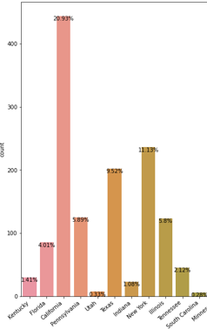
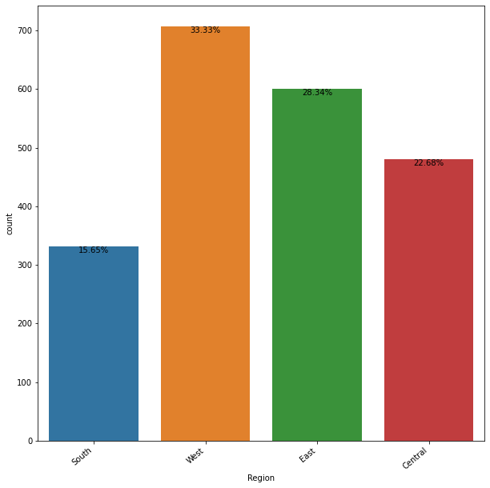
Exploratory data analysis(EDA) --univariate
50% sales are generating only from 5 states out of 49 states
Sate wise we can see that 20.93% sales are generating from California which is on number one.
New York with 11.13% is on second number.
Texas is on number third with 9.52% sales
Illinois and Pennsylvania is on 5.8%
West Region is leading in terms of sales followed by East and central region.
State wise Analysis
Region wise Analysis

Slide 6
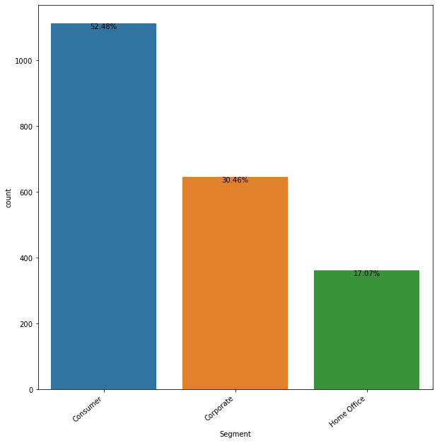
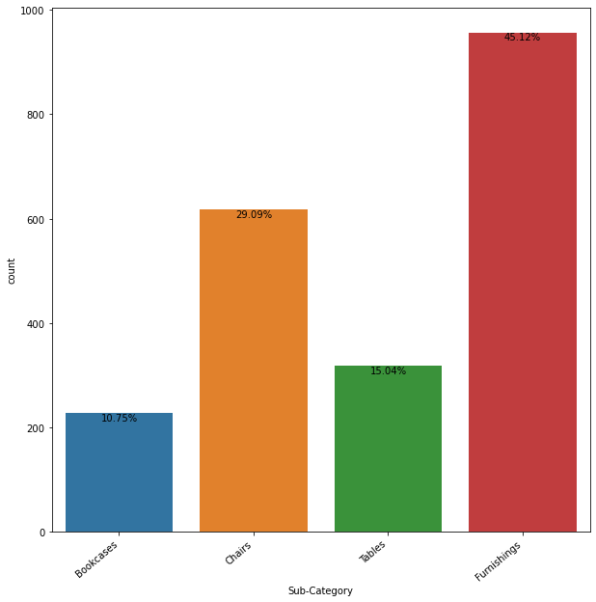
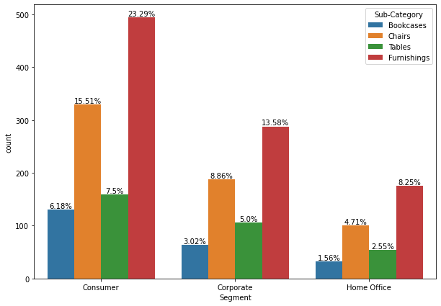
Exploratory data analysis(EDA) –Bi variate and Multivariate
Univariate of Segment
Univariate of Sub-Category
Bivariate of Sub-Category with segment
Sales from Consumer Segment is highest among all three segment and around 23.29% market is captured by Furnishing Category

Slide 7
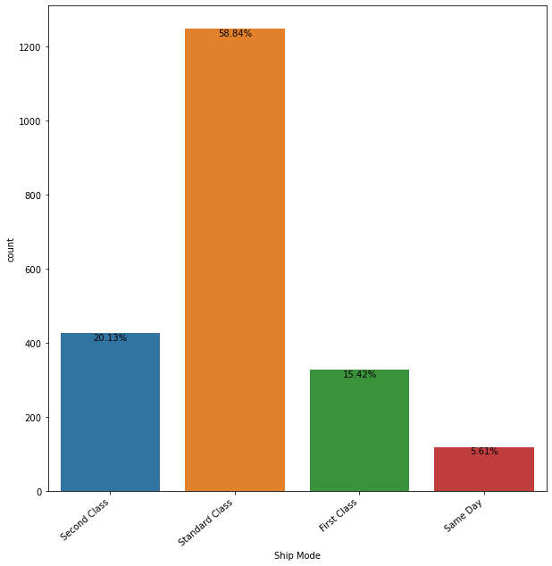
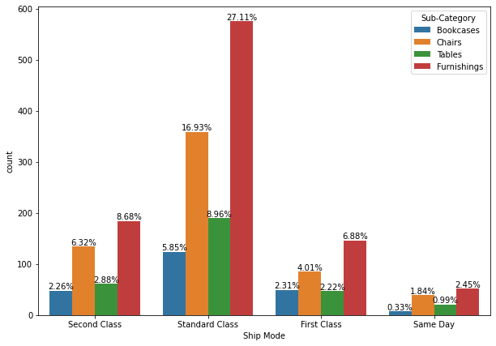
More analysis
Univariate of Ship Mode
Univariate of Sub-Category
Bivariate of Sub-Category with Ship Mode
We can see that in Standard class segment Furnishing-category is on top and bookcases is on last in same day segment

Slide 8
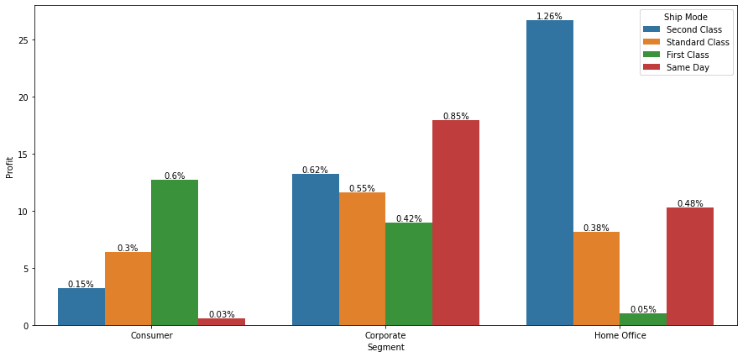
Multivariate analysis
This analysis is Segment wise profit including shipping mode as a third variable .
we can observe that from the home office segment , Second class shipping method is more popular and making good profit
In consumer segment we can close the Same day services as profit is negligible similarly First class service in Home office segment

Slide 9
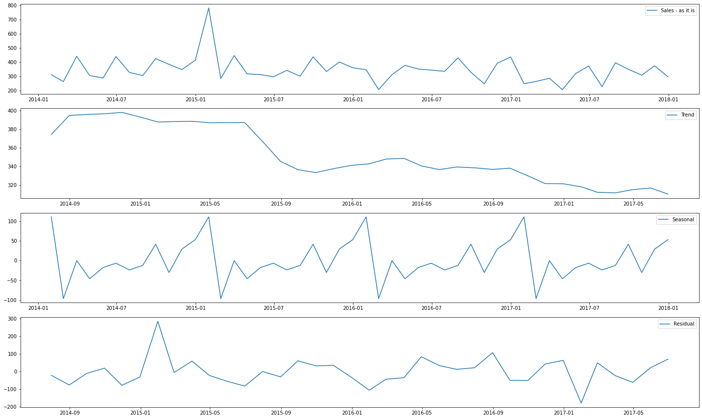
Some visual inspections about the data.
Sales
Trend
Seasonal
Residual

Slide 10
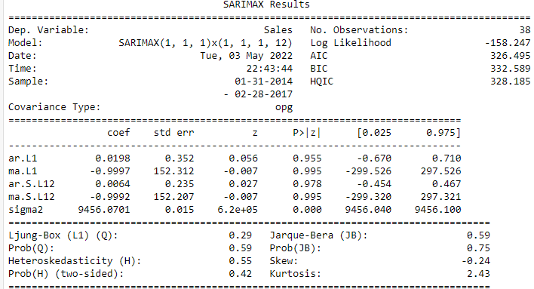
Model Building:
Using SARIMA
Autoregressive Integrated Moving Average, or ARIMA, is one of the most widely used forecasting methods for univariate time series data forecasting.
Although the method can handle data with a trend, it does not support time series with a seasonal component.
An extension to ARIMA that supports the direct modeling of the seasonal component of the series is called SARIMA.

Slide 11
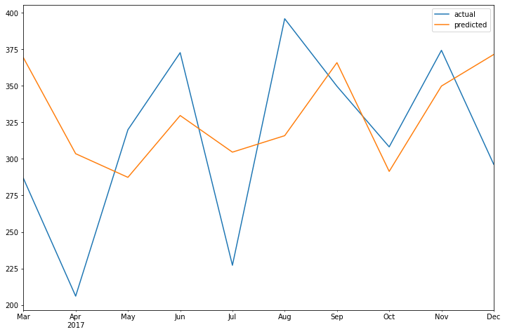
Actual vs predicted values :
Actual vs predicted values table
Actual vs predicted values Graph
actual | predicted | err
286.669600 | 369.245085 | -82.575485
206.044502 | 303.546194 | -97.501692
319.953928 | 287.365429 | 32.588500
372.717386 | 329.683622 | 43.033764
227.173500 | 304.617416 | -77.443916
395.945487 | 315.885778 | 80.059710
349.737422 | 365.883671 | -16.146249
308.226313 | 291.427462 | 16.798851
374.310253 | 349.858806 | 24.451446
296.296857 | 371.456368 | -75.159512

Slide 12
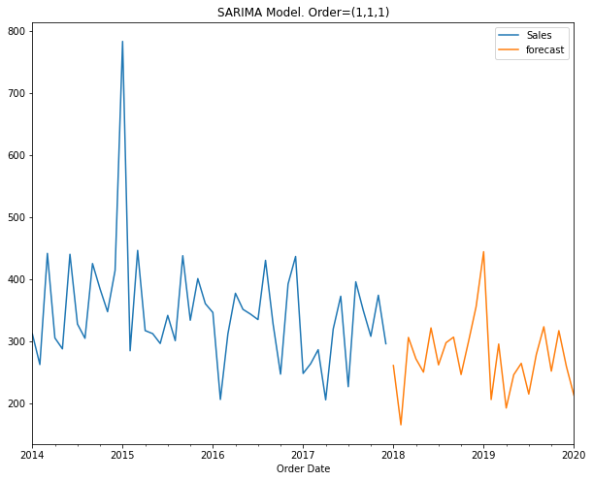
a forecast using SaRIMA model to predict the Furniture sales
From last 4 year data 2014-17 we are forecasting sales of next
2 Year

